Slide 1
Lecture 1 – Introduction to Mobile Application
Mr. Yousif Garabet Arshak
Computer Science Department
University of Zakho
yousif.arshak@uoz.edu.krd

Slide 2
Outlines
Prerequisite course
Assessment plan
Market Share iOS/Android
Introduction to Mobile Application
Designing Mobile Application Contents
Creating project
Lab Exercises
Mini Projects
Any Questions?

Slide 3
Prerequisite Course
Object Oriented Programming
Web Engineering
Data Base Design
Mobile Application Development

Slide 4
Assessment plan
Activities | Mid-Term |  | Final
30% | 20% |  | 50%
Assignments, Quizzes, Reports, Projects & Presentations | Theory | Practical | Theory | Practical
30% | 10% | 10% | 30% | 20%

Slide 5
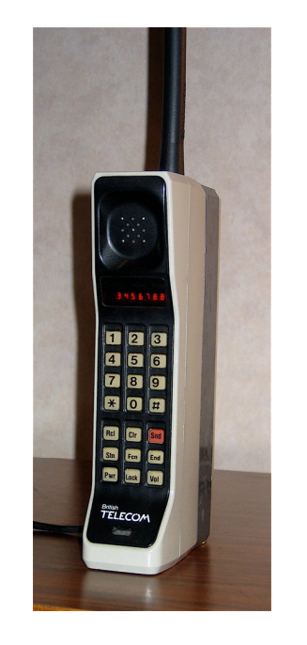
IN THE BEGINNING MOTOROLA DYNATAC 8000X
Introduction to Mobile Application

Slide 6
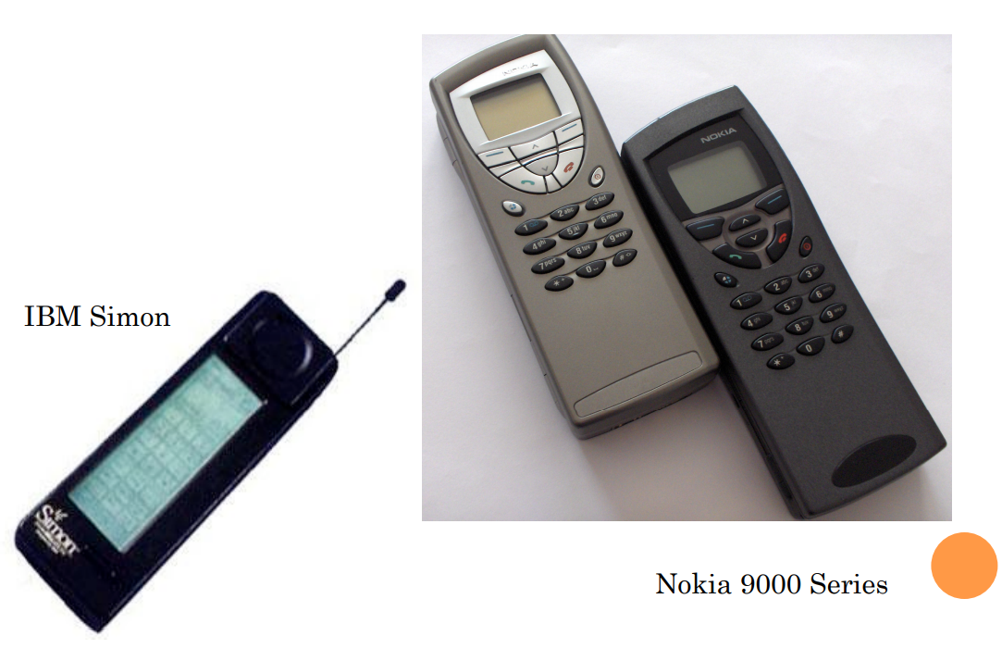
EARLY SMART PHONES

Slide 7
WHAT IS A “SMARTPHONE”
Semi-Smart: Phone that offers features beyond making calls
E-mail
Take pictures
Plays mp3
…
Phone that runs a complete Operating System
Offers a standardized platform for development
Able to execute arbitrary 3rd party applications

Slide 8
QUICK FACTS
Today
Cell phones in use today ~ 7.95 billion
Smartphones account for 14% ~ 170 Million

Slide 9
MOBILE DEVELOPMENT SOLUTIONS
Java ME
Symbian
UIQ
S60
Android
BlackBerry
OVI
Windows Mobile
iPhone
LiMo
Ångström distribution
Adobe Flash Light
BREW
OpenMoko
Palm OS (Garnet OS, Cobalt OS)
Palm webOS Mojo

Slide 10
COMMON PROBLEM: ABSTRACTION
Interface / GUI
How does the developer create an interface
Different interaction techniques
Graphical capabilities of the phone
Phone Services and Security
What resources are available to your program
What types of boundaries or constraints are put on applications
How can code be considered “safe”

Slide 11
THREE TIERED SOLUTION
Virtual Environment
Java ME
BREW *
Core Operating System
Symbian
LiMo
Rich Operating System
Android
iOS

Slide 12
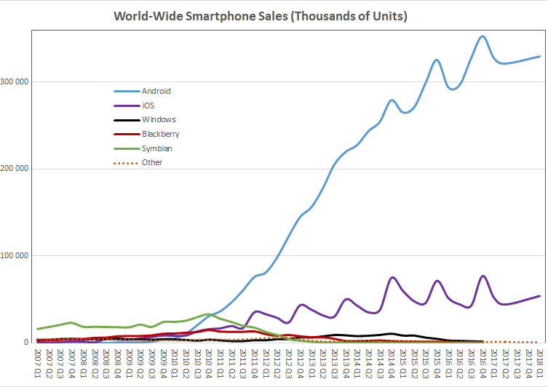
Smartphone Sales
Source : https://en.wikipedia.org/wiki/Mobile_operating_system

Slide 13
Android vs iOS
iOS 28.26%
Android 71.24%
Other 0.5

Slide 14
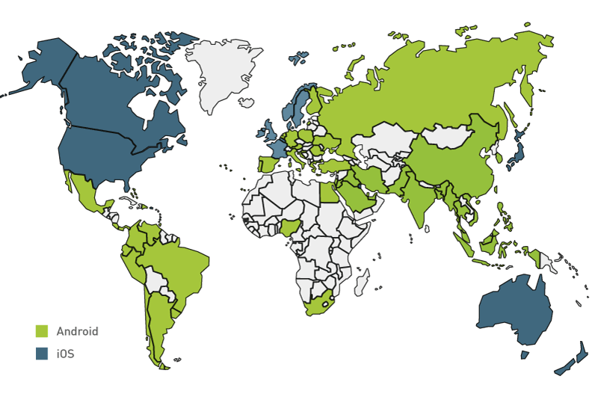
Market Share iOS/Android
Source : https://lvivity.com/android-vs-ios-app-development-platform

Slide 15
Device Types
Source: netmarketshare

Slide 16
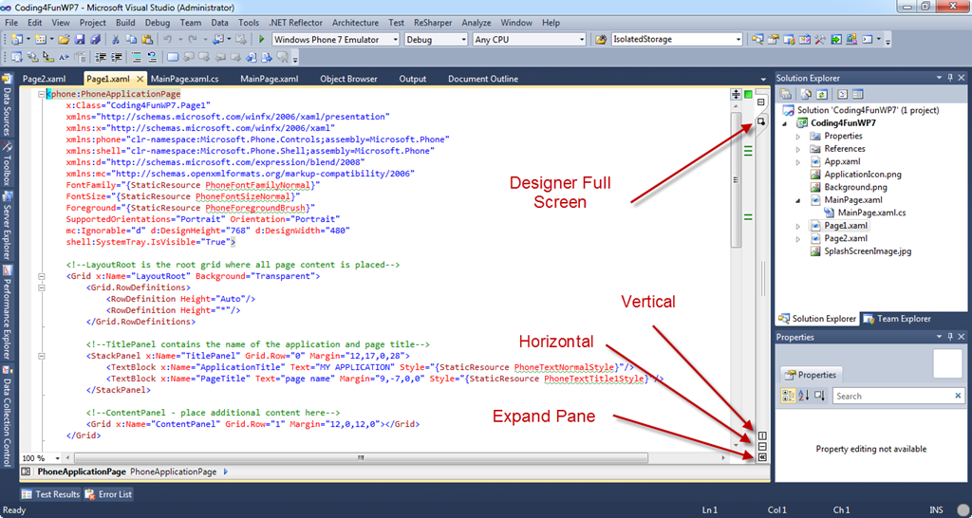
Designing Mobile Application Contents
Aim: To learn how to designing a mobile application contents using XAML.

Slide 17
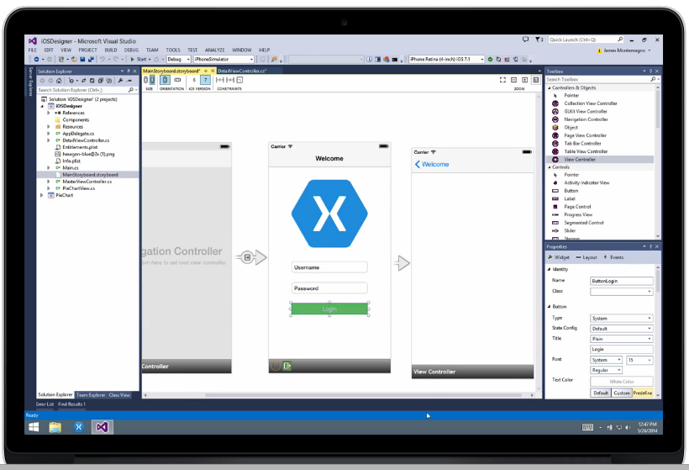
Creating project
We will use Visual Studio (Xamarin.Forms) to create Android/ IOS applications

Slide 18
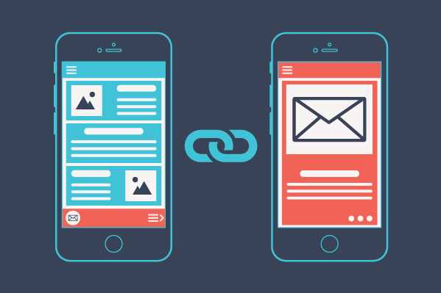
Lab Exercises

Slide 19
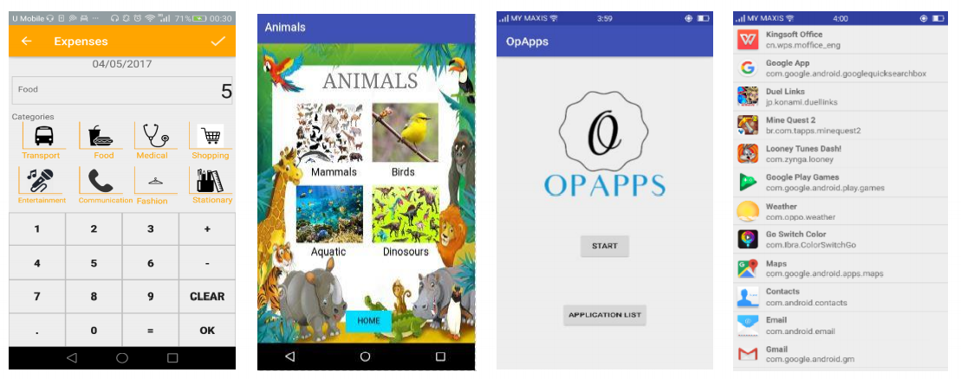
Mini Projects

Slide 20

Any Questions?

